Slide 1
I See Dead Pipelines...Without CI/CD”: The Gen AI Easy Button for Fine-Tuning, Evaluation, and Inference With NVIDIA NIMs and Nemo Microservices
Notes:
Hello and welcome. The presentation having this long title basically introduces an easy-to-use e2e framework leveraging NVIDIA NIMs and NeMo Microservices for fine-tuning, evaluating, and deploying AI models in a GitOps-based approach.
In this lab, we will build this full automation from scratch, walking through how to set up a CI/CD pipeline that streamlines model fine-tuning, evaluation, and inference—ultimately enabling a fully automated and scalable AI workflow.

Slide 2
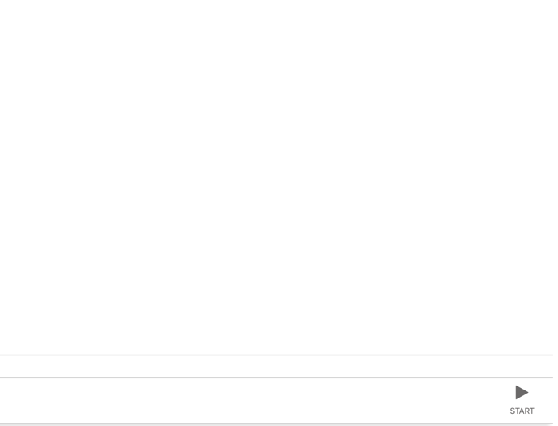
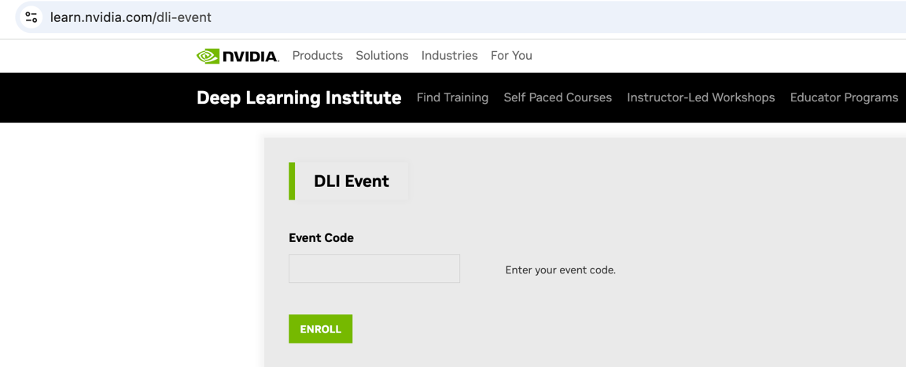
Launching the Lab
Go to https://learn.nvidia.com/dli-event
Enter event code: <given at the time of lab>
You may need to login/create account.
Click on this

Slide 3
Agenda
Part 1: Kubernetes Basics and GitOps Lecture: Basics of Kubernetes and introduction to GitOps and ArgoCD Labs: 1. Overview of The Class Environment, and 2. GitOps using ArgoCD
Part 2: NIMs, Nemo Microservices and components Lecture: Introduction to NIMs and Nemo Microservices Labs: 3. Nemo Microservices Components Deployment, 4. Nemo Microservices Deployment
Part 3: Fine-tuning process and automation Lecture: Discussion on Fine Tuning process and creating workflows in Argo Workflows for automation Labs: 5. Interactive Fine Tuning using Nemo MS and 6. Fine Tuning Automation Pipelines using Argo Workflows
Notes:
The agenda is divided into three parts. Since this lab is only 1.5 hours long, we’ll cover as much as possible within the time limit. However, the main goal is for you to walk away with a Git repository containing everything you need to replicate and implement this in your own environment.
While we may not complete every step during the session, you’ll have full access to all materials, allowing you to explore and finish the setup at your own pace later.
We'll begin with the fundamentals of Kubernetes, followed by an introduction to GitOps and ArgoCD to set the foundation. Next, we'll dive into NVIDIA NIMs and NeMo Microservices, exploring their capabilities. Finally, we'll see how you can leverage NeMo Microservices for fine-tuning models and building fully automated AI pipelines.

Slide 4
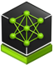
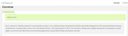

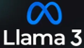



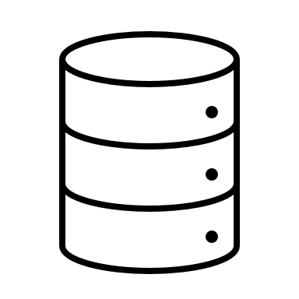
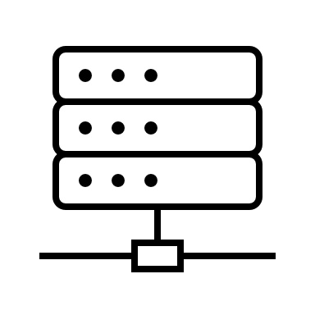
Why this lab?
Generative AI Development and Deployment requires Multiple Roles, Diverse Skills, Multiple Jargon
NIM
ML Engineer
Application Developer
AI model Optimization for High Performance Inference
AI Application
Data Scientist ML Engineer
MLOps, DevOps
Training/Finetuning Models
Serve, Monitor, Scale
Data Engineer
IT, Security
Data Management
Configure, manage HW/SW resources.
Notes:
Developing and deploying Generative AI models is a complex, multi-step process that requires collaboration across multiple roles, a diverse skill set, and an understanding of various technical concepts and jargon. From data scientists and ML engineers to DevOps and platform teams, each plays a critical part in the AI lifecycle. AI development spans data engineering, model training, fine-tuning, evaluation, infrastructure management, and deployment. One of the biggest challenges is automation and reproducibility, which is where DevOps plays a crucial role. Without proper CI/CD pipelines, AI workflows can become manual, error-prone, and difficult to scale.
This lab focuses on simplifying and automating the AI pipeline using NVIDIA NIMs, NeMo Microservices, and GitOps-based CI/CD, making it easier to manage, reproduce, and deploy Generative AI models at scale.

Slide 5
Agenda
Part 1: Kubernetes Basics and GitOps Lecture: Basics of Kubernetes and introduction to GitOps and ArgoCD Labs: 1 Overview of The Class Environment, and 2 GitOps using ArgoCD
Part 2: NIMs, Nemo Microservices and components Lecture: Introduction to NIMs and Nemo Microservices Labs: 3 Nemo Microservices Components Deployment, 4 Nemo Microservices Deployment
Part 3: Fine-tuning process and automation Lecture: Discussion on Fine Tuning process and creating workflows in Argo Workflows for automation Labs: 5 Interactive Fine Tuning using Nemo MS and 6 Fine Tuning Automation Pipelines using Argo Workflows
Part 1: Kubernetes Basics and GitOps (Lecture)
Notes:
This lab is designed around Kubernetes to align with real-world, production-grade deployments. To ensure a solid foundation, we'll start with a quick recap of Kubernetes fundamentals, followed by an introduction to the GitOps methodology, which streamlines automation and deployment in AI workflows.
Quick raise of hands who are familiar with Kubernetes and have used it for deploying workloads

Slide 6
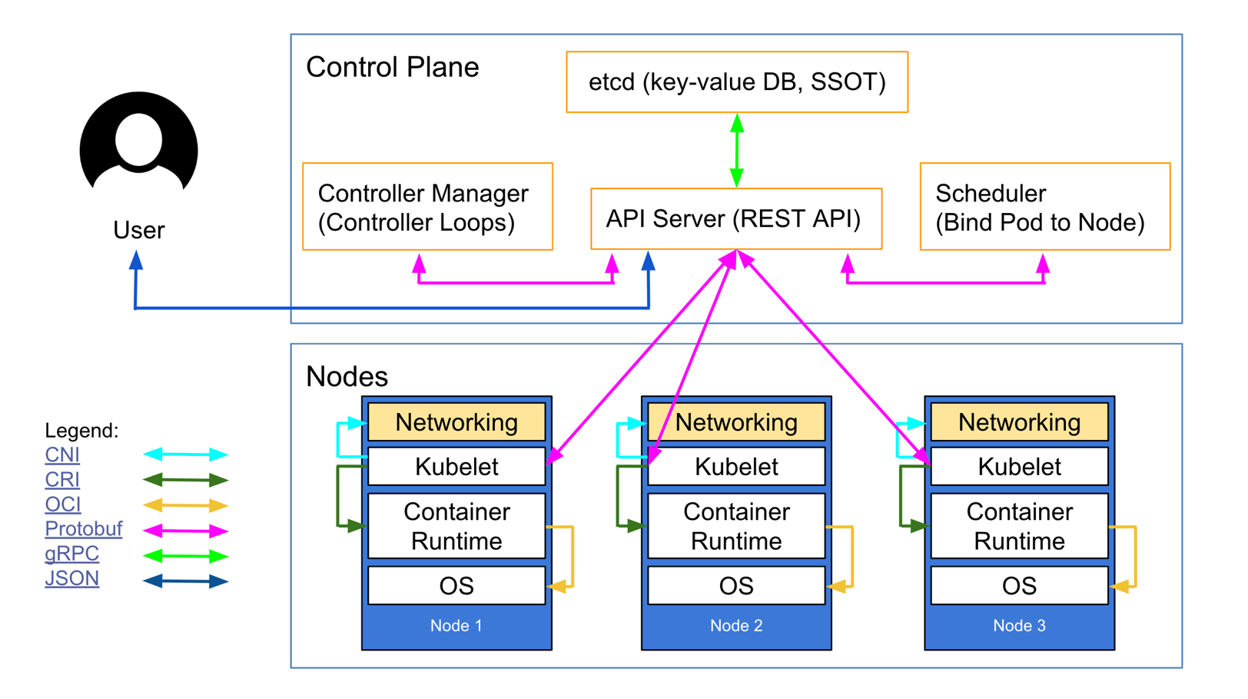
Kubernetes Architecture
Overall Architecture – Control Plane and Worker Nodes
Notes:
This is what Kubernetes’ architecture looks like on a high level
Kubernetes follows a master-worker architecture, where the control plane manages the cluster, and worker nodes run applications.
Control Plane (Master Components): Manages and orchestrates the cluster. Key components:
API Server – The central entry point that handles all Kubernetes requests.
Controller Manager – Manages controllers for maintaining the cluster state (e.g., node monitoring, replication).
Scheduler – Assigns workloads (Pods) to worker nodes based on resource availability.
etcd – A distributed key-value store that holds cluster state and configuration.
Worker Nodes Run applications inside containers. Key components:
Kubelet – Agent on each node that ensures containers are running as expected.
Kube Proxy – Manages networking and routing within the cluster.
Container Runtime – Runs containers (e.g., Docker, containerd, or CRI-O).
Kubernetes uses CNI plugins (like Calico, Cilium, or Flannel) to enable pod-to-pod communication, network policies, and traffic routing within the cluster. This ensures seamless connectivity between workloads across nodes.

Slide 7
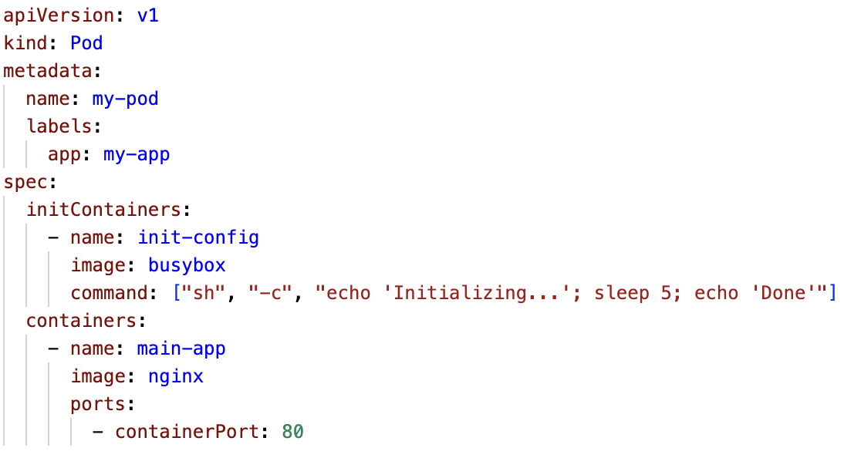
Kubernetes Core Concepts
What is the minimum deployable unit?
Pod
Defined by YAML (as with everything else)
Smallest K8s compute resource containing containers
contains
Init Container
Container
Container executing startup tasks
Main or sidecar application

Slide 8
Kubernetes Core Concepts
How do we define POD behaviors?
Similar to your Linux Daemons and runs a specific POD on all (or subset) of nodes in your cluster:
Export Node level metrics
Intrusion detection system
GPU drivers
DaemonSet
Creates exactly one Pod per Node
Job
Useful for single point in time tasks that are not part of a persistent application:
Data backup
ETL pipeline and report generations
ReplicaSet
Ensures your requested number of Pods are always running
StatefulSet
Handles many pods while maintain a persistent identity for each:
Particularly useful for stateful applications: Databases

Slide 9
Kubernetes Core Concepts
Workloads
HPA
Deployment
CronJob
Scales the number of pods based on various metrics
Creates a ReplicaSet and do rollouts and rollbacks
Creates Jobs based on a time schedule
StatefulSet
ReplicaSet
Job
DaemonSet
Creates Pods while handling the needs of stateful apps
Creates a desired amount of Pod instances
Creates short living Pods for one-time executions
Creates exactly one Pod per Node
Pod
Smallest K8s compute resource containing containers
contains
Init Container
Container
Container executing startup tasks
Main or sidecar application

Slide 10
Kubernetes Core Concepts
Storage
Persistent Volume Claim
Requests a part of
Persistent Volume
Requests storage from a PV- amount & access mode
Etcd store
Abstraction of a storage container
Refers to
Storage Class Provisioner
mounts
Storage Class
Service that creates PVs for a certain SC
Read
from
Refers to
Configuration of different types of storage eg. NFS, Local
GCEPersistentDisk
AWSElasticBlockStore
NFS
iSCSI
RBD (Ceph Block Device)
Glusterfs
HostPath
Pod
Compute unit that reads/writes from/to the storage
mounts
ConfigMap / Secret
emptyDir
/mount/data
Generic Ephemeral Volumes
Contains read only mounted data
A temporary local storage during lifespan of pod
Our PVC is mounted and accessible here
Creates temporary PVCs using existing SCs

Slide 11
Manage ALL of this to deploy an application!?
Persistent Volume Claim
Requests storage from a PV- amount & access mode
HPA
Init Container
Scales the number of pods based on various metrics
Container executing startup tasks
Pod
Persistent Volume
Storage Class Provisioner
Smallest K8s compute resource containing containers
Abstraction of a storage container
StatefulSet
Service that creates PVs for a certain SC
Creates Pods while handling the needs of stateful apps
CronJob
ReplicaSet
Creates Jobs based on a time schedule
Creates a desired amount of Pod instances
DaemonSet
Creates exactly one Pod per Node
Container
Storage Class
Deployment
Job
Configuration of different types of storage eg. NFS, Local
Creates a ReplicaSet and do rollouts and rollbacks
Main or sidecar application
Creates short living Pods for one-time executions

Slide 12
GitOps to the rescue
Introduction to GitOps
A way to manage cloud-native applications/Infrastructure.
Leverages Git as the single source of truth.
A GitOps agent (Flux, ArgoCD) automatically applies all code, configuration, & policies across environments.
If there is any divergence between Git and what's running in a cluster, automatically update or roll back the cluster.
Notes:
A path towards a self-service developer experience for managing applications and automating CI/CD pipelines, unifying development and operations teams.

Slide 13
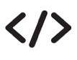

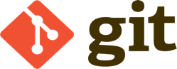
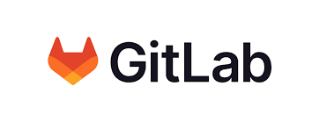
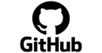
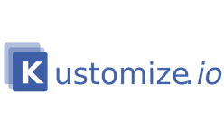
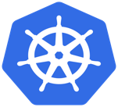
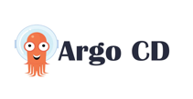
GitOps-based Pull Workflow for App Deployment
1
2
3
Commits code
Create PR
Developer(s)
Application
Repository
Continous Integration (CI) Pipeline
Image Repository
4
4
Jenkins
GitHub
Actions
Updates
Manifests
Update Manifests
and create PR
5
Dev
Continuous Delivery
Sync (Pull)
Kubernetes Manifests
Repository
Prod

Slide 14
GitOps-based Pull Workflow for App Deployment
Pros and Cons
In pull-based approach, all changes are applied from inside the cluster.
There is an operator/agent inside the cluster, that regularly scans the associated git repositories and docker registries and if a change occurs, the cluster state will be updated from inside.
Through the pull approach, you are bound to the tools executing the pull.
limited to Kubernetes only
No external client has the right to publish to the cluster, all updates are coming from inside.
changes can be automatically detected and applied without human intervention easier scaling of identical clusters

Slide 15

Continuous Delivery Sync using ArgoCD
Introduction to ArgoCD
It is a declarative, GitOps continuous delivery tool for Kubernetes.
ArgoCD follows the GitOps pattern of using Git repositories as the source of truth.
Kubernetes manifests in ArgoCD can be specified in several ways:
kustomize applications
helm charts
Plain directory of YAML/json manifests
It continuously monitors running applications and compares the current, live state against the desired target state (as specified in the Git repo).
Notes:
flux aprt from argocd, why argocd

Slide 16
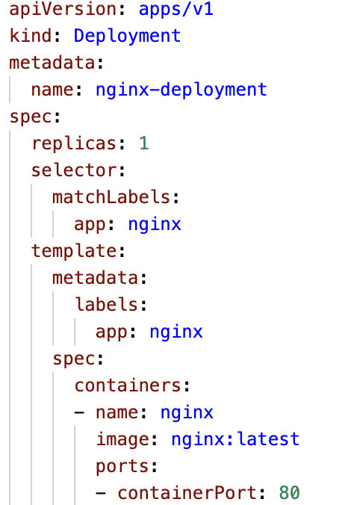
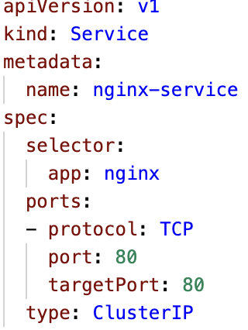
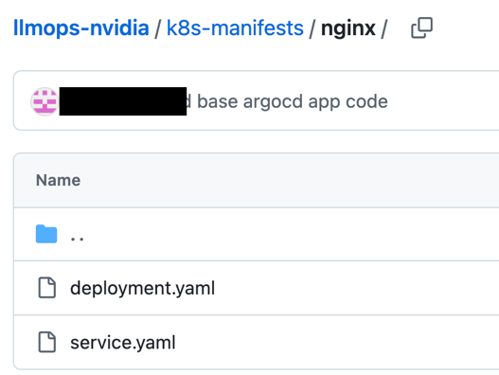
Continuous Delivery Sync using ArgoCD
Example NGINX Manifest Files
deployment.yaml
service.yaml
pushed to Git

Slide 17
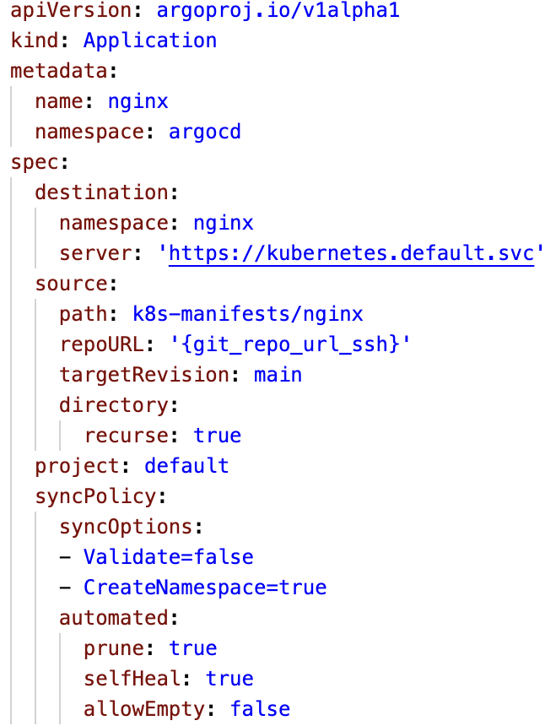
Continuous Delivery Sync using ArgoCD
ArgoCD Application Explanation
Custom CRD for the ArgoCD
Destination Namespace and Cluster
Source information. We can also specify helm repo and custom values here
Sync parameters used by ArgoCD

Slide 18
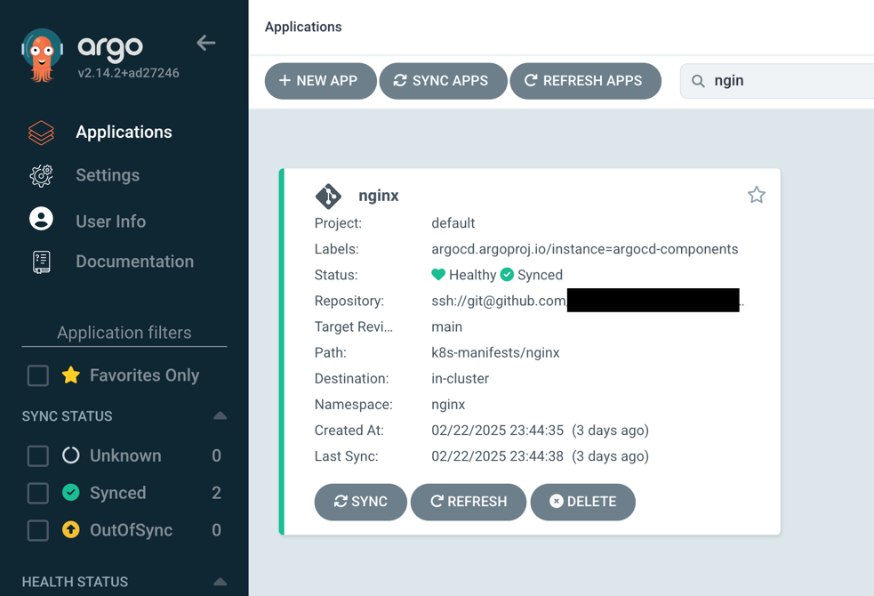
ArgoCD Application
Example NGINX Application

Slide 19
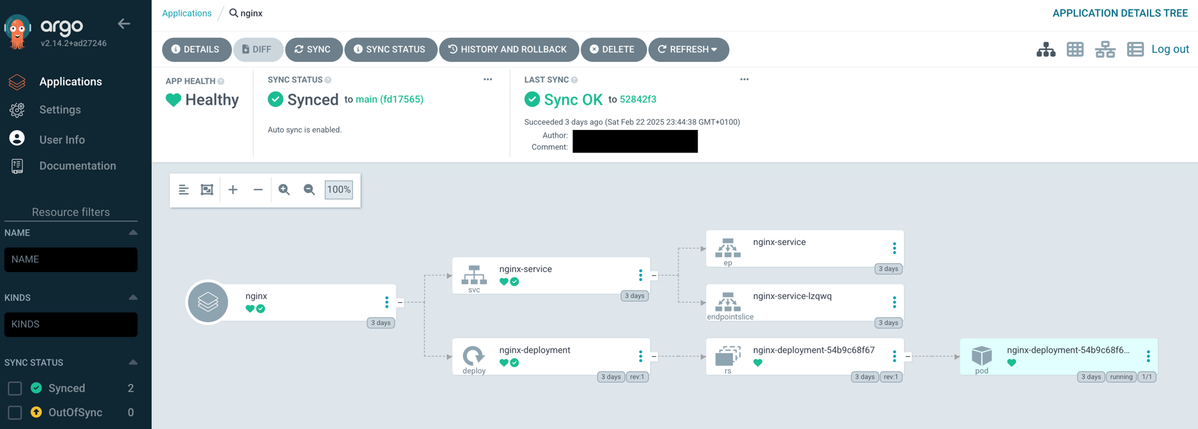
ArgoCD Application
Example NGINX Application

Slide 20
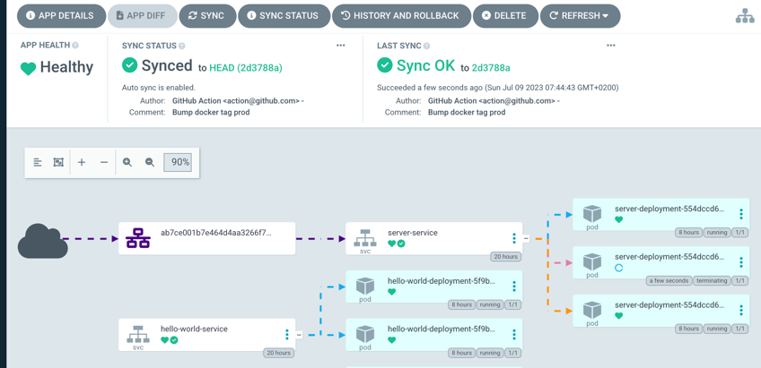
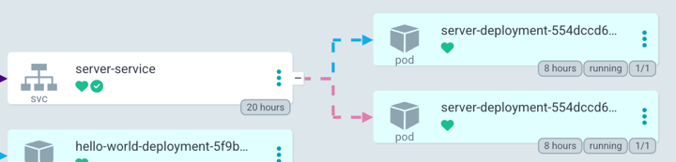
Continuous Delivery Sync (ArgoCD)
What happens if someone update the cluster manually?
Sync Changes to the cluster from the Git version
Server replicas : 3
Actual State != Desired State

Slide 21
Hands-on (Notebook 1, 2)
1. Environment Overview
2. Connecting Git repository to ArgoCD

Slide 22
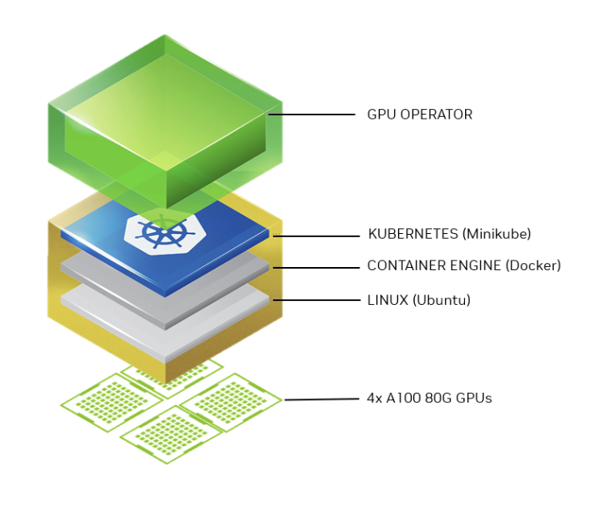
1. Environment Overview
The Lab Environment
Automate software components for NVIDIA HW in K8s
Container orchestration
Docker container runtime
Notes:
Hence, Our lab environment looks like as shown in the slide. It consists of DGX A100 with 4 GPUs as a host with Ubuntu as the operating system. Docker is used as the continer engine. Kubernetes is deployed on it using MiniKube; To enable GPU utilization in Kubernetes, we install essential NVIDIA software components using the GPU Operator.

Slide 23
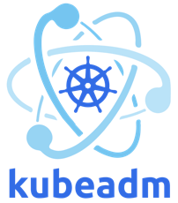
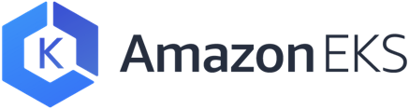
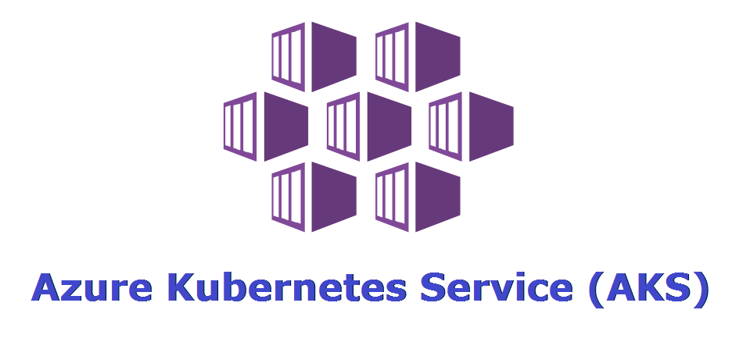
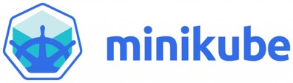
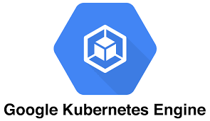
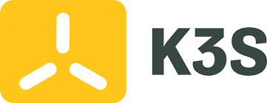
1. Environment Overview
Kubernetes Installation Tools
CSPs based tools
Self-hosted based tools
Notes:
Kubernetes can be deployed using various tools for example cloud service providers' offerings such as AWS's EKS, Azure's AKS, or GCP's GKE can be utilized. Or for self-hosted K8s, one can use Kubeadm, minikube or k3s. There exists several others. In this lab, we leverage MiniKube for deploying Kubernetes.

Slide 24
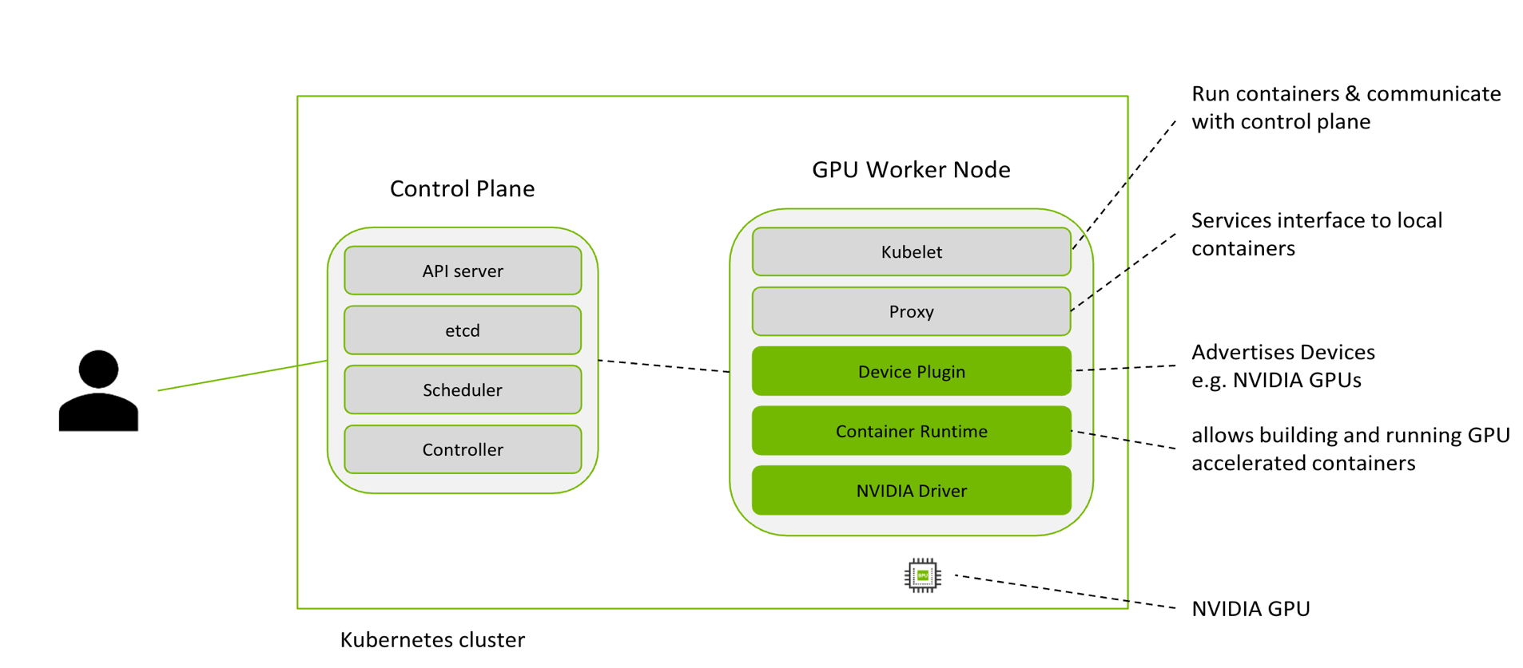
1. Environment Overview
What does a GPU K8s cluster look like?
Notes:
Nvidia Container runtime support docker, LXC and CRI-O

Slide 25

1. Environment Overview
What is helm and helm charts?
Helm Repository
Helm Chart
1) Get helm charts
Contains actual resources (deployments, services, secrets etc. ) information that need to be deployed
Example: NGC Private Registry
2) Uses values.yaml to resolve parameters in the chart.
values.yaml
3) Deploy
Contains actual configuration for each resource.
Kubernetes Cluster
Notes:
In the notebook we will deploy the some of the stuff like NIM Operator via the helm chart. Therefore, let’s understand first what is helm Helm chart.
Helm is a tool that automates the creation, packaging, configuration, and deployment of Kubernetes applications by combining configuration files into a single reusable package. This reusable package is called a Helm chart.
A Helm chart is a package that contains all the necessary resources to deploy an application to a Kubernetes cluster. This includes YAML configuration files for deployments, services, secrets, and configs.
Helm pulls Helm charts from a Helm repository such as the NGC private registry. Users adjust the values.yaml file, which contains the actual configuration for each resource, depending on the environment and need.
Then Helm resolves parameters within the Helm chart using values.yaml before deploying on the Kubernetes cluster.

Slide 26
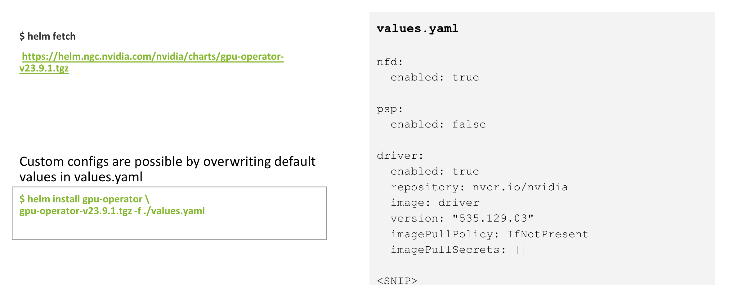
1. Environment Overview
NVIDIA GPU Operator Helm Chart

Slide 27
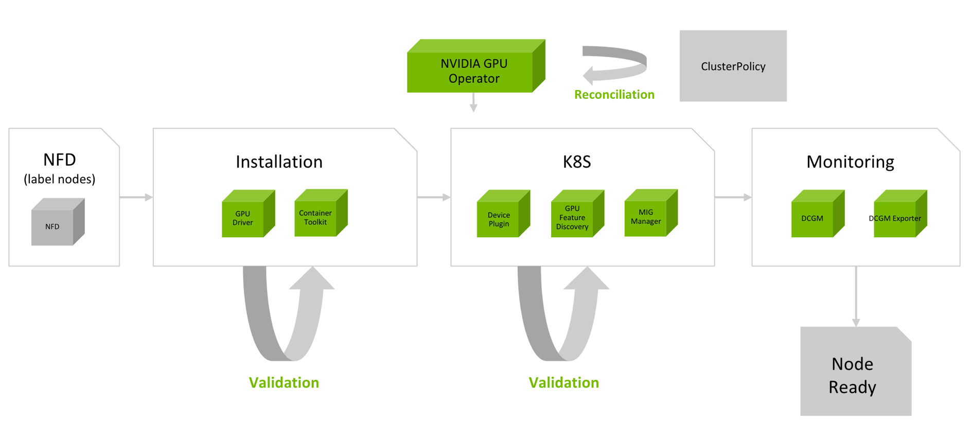
GPU Operator
NVIDIA GPU Operator Pod – Orchestrates all Components
Notes:
Let’s now take a look at how the GPU Operator operands are orchestrated.
As mentioned, the GPU Operator acts as the control plane for your GPU worker nodes.
It watches our CustomResource, named ClusterPolicy, which contains the desired state of the GPU Operands, as defined from the helm chart file values.yaml.
The Operator reconciles the desired state with the observed state in the cluster, to ensure your GPU worker nodes are running the desired set of operands.
Once the helm chart is installed, a ClusterPolicy instance is created, and on each GPU worker node, the following will occur.
Starting on the left, Node Feature discovery will label the node.
Based on these labels, the GPU Operator will detect the presence of a GPU and initiate the deployment of the Operands to the worker node in the affirmative case.
The Operands will be installed in the order shown on the diagram, starting with the GPU Driver and ending with the Monitoring components.
As shown by the green arrows, the GPU Operator performs a series of validations as components are deployed to make sure they are operating correctly.
If any validation fails, GPU operator will stop installing the rest of the stack.
For example, after the Container Toolkit is installed, we launch a sample pod that requests a GPU and we validate that it can properly access the device.
If it can’t, we know we cannot proceed with the rest of the operands so we stop.
This helps cluster admins easily diagnose which component in the stack is failing and work towards finding a root cause.

Slide 28
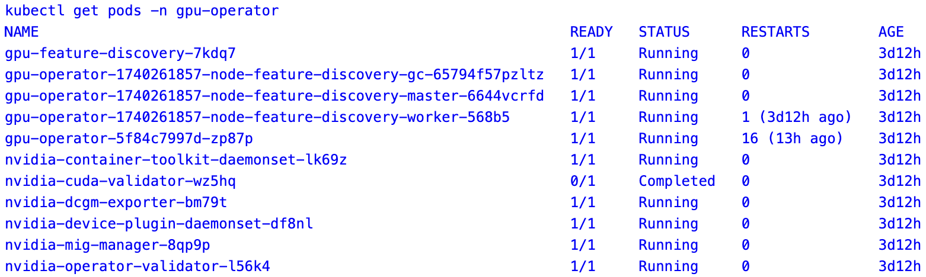
1. Environment Overview
GPU Operator Pods

Slide 29
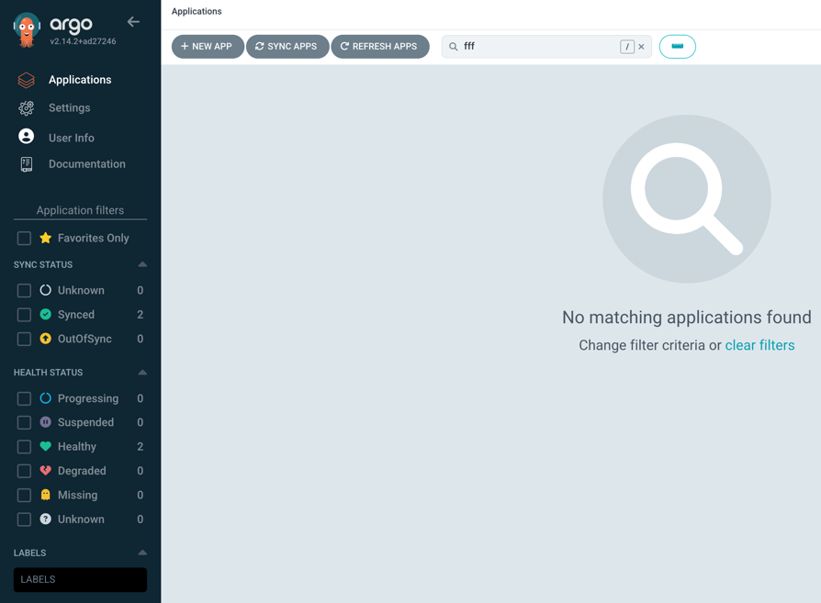
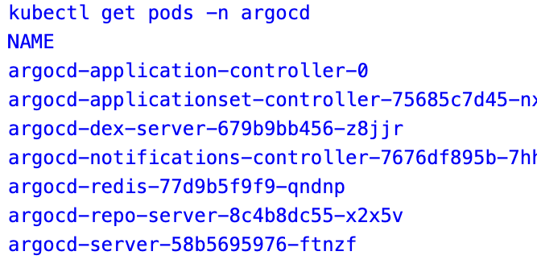
2. Connecting Git repository to ArgoCD
ArgoCD already been Deployed

Slide 30

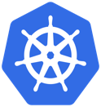
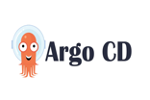
2. Connecting Git repository to ArgoCD
Overall workflow
1
Add Example K8s manifests
Add ArgoCD Application for tracking it
Commits code
2
3
+
Continuous Delivery
Sync (Pull)
Create PR
Sync
Deploy
Code
Repository
K8s Cluster

Slide 31
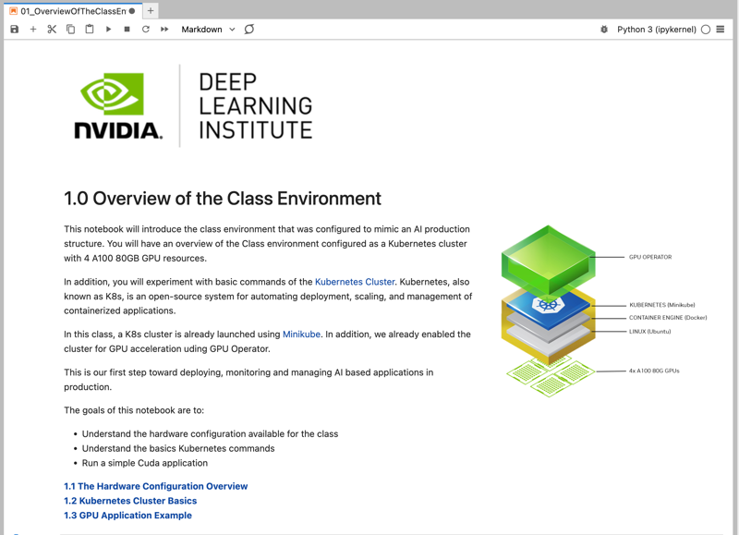
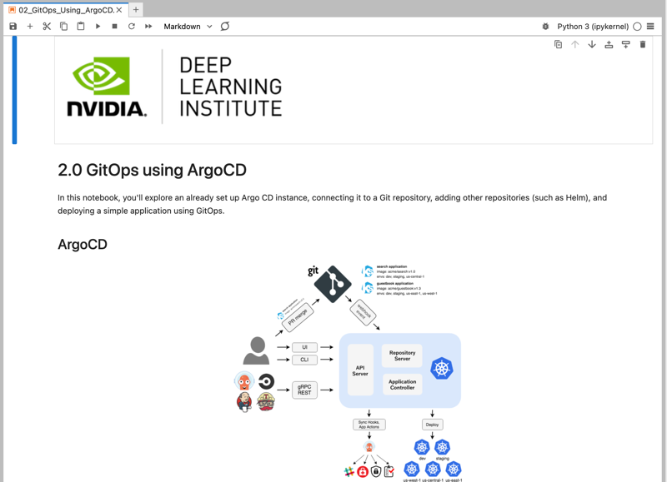
Lab 1 and Lab 2
Open Notebook: 01_OverviewOfTheClassEnvironment.ipynb
The node HW configuration Overview
Kubernetes basic commands
Deploying a basic GPU application
Open Notebook: 02_GitOps_Using_ArgoCD.ipynb
Explore ArgoCD and Creating a Git repo.
Create example ArgoCD application
Connecting ArgoCD to Git Repo repository

Slide 32
Agenda
Part 1: Kubernetes Basics and GitOps Lecture: Basics of Kubernetes and introduction to GitOps and ArgoCD Labs: 1 Overview of The Class Environment, and 2 GitOps using ArgoCD
Part 2: NIMs, Nemo Microservices and components Lecture: Introduction to NIMs and Nemo Microservices Labs: 3 Nemo Microservices Components Deployment, 4 Nemo Microservices Deployment
Part 3: Fine-tuning process and automation Lecture: Discussion on Fine Tuning process and creating workflows in Argo Workflows for automation Labs: 5 Interactive Fine Tuning using Nemo MS and 6 Fine Tuning Automation Pipelines using Argo Workflows
Part 2: NIMs, Nemo Microservices and Components
(Lecture)
Notes:
We now will introduce NIMs and Nem Microservices.

Slide 33
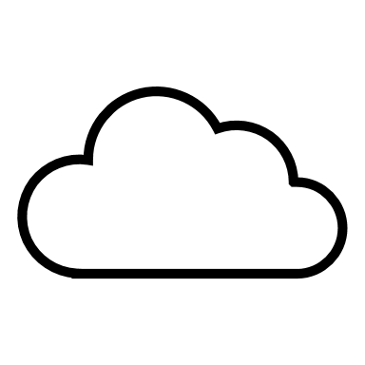
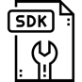
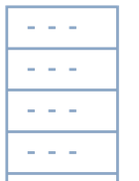
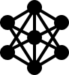
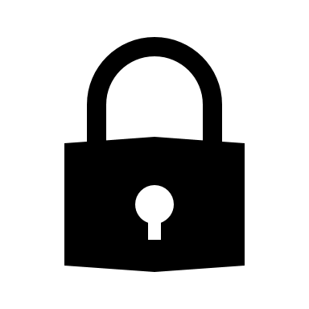



Challenges Experimenting with Generative AI
Organizations must choose between ease of use and control
Managed Generative AI Services
Do-It-Yourself Deployment
Easy to use APIs for development
Run anywhere across data center and cloud
Fast path to getting started with AI
Securely manage data in self hosted environment
API
Infrastructure limited to managed environment
Optimization required for specific infrastructure
Data and prompts are shared externally
Custom code for APIs and fine-tuned models
Limited control for overall generative AI strategy
Enterprise Controlled Environment
Enterprise Controlled Environment
Ongoing maintenance and updates
Notes:
Many of the companies we talk to have already begun the process of building AI applications.
On one side, we have Managed Generative AI Services. These are touted for their simplicity and user-friendly APIs, which allow rapid development and a quick launch into the AI sphere. They provide a fast path to getting started with AI, requiring less initial infrastructure setup, thus enabling a quicker go-to-market.
However, these benefits come with certain trade-offs. The infrastructure is typically limited to a managed environment, and data, including prompts, may be shared externally. There's a dependency on the service provider's systems and protocols. This can result in limited control over your generative AI strategy, which can be a significant drawback for some organizations, particularly those with stringent data governance and privacy standards.
On the flip side, we have Open-Source Deployments. The main advantage here is the flexibility to run your AI models anywhere—across different data centers and cloud environments. It allows enterprises to securely manage their data within a self-hosted environment, which is vital for compliance and proprietary concerns.
However, this increased control requires a greater commitment to the infrastructure. It involves tuning for different infrastructure, writing custom code for APIs, and potentially more intricate model fine-tuning to optimize performance. Additionally, there's the responsibility of ongoing maintenance and updates, which can be a significant resource commitment.
Has your organization already begun deploying using one of these approaches? What challenges are you facing?

Slide 34
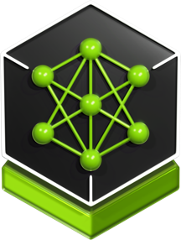
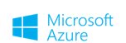
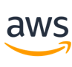
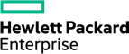



NVIDIA NIM Optimized Inference Microservices
Accelerated runtime for generative AI
NVIDIA NIM
Deploy anywhere with security and control of AI applications and data
Speed time to market with prebuilt, continuously maintained microservices
Prebuilt container and Helm chart
Industry standard APIs
Empower developers with the latest AI models, standard APIs and enterprise tools
Support for custom models
Optimize throughput and latency to maximize token generation and responsiveness
Domain specific code
Boost accuracy by tuning custom models from proprietary data sources​
Optimized inference engines
Deploy in production with API stability, security patching, quality assurance and enterprise support​
DGX &
DGX Cloud
Notes:
NVIDIA NIM provides the best of both worlds. A simple way to deploy AI models that can be developed using a standard API path.
Moving upwards, we've adopted industry-standard APIs in conjunction with NVIDIA Cloud standards to facilitate seamless integration and interoperability across systems.
For those working in specialized fields, we provide domain-specific code for a variety of NIM domain categories, including Large Language Models (LLMs), Vision Language Models (VLMS), video processing, healthcare, and more. This ensures that you have the tools necessary for your specific use case.
Our inference engines are optimized for each model and hardware SKU, delivering unparalleled performance no matter the application.
We also recognize the importance of customization. That’s why we offer support for custom models built by users for targeted use cases, ensuring that you can adapt our technology to your unique requirements.
All of this is built on an NVIDIA AI Enterprise base container, guaranteeing a reliable and secure foundation for your AI applications.
By combining all of these powerful tools into the NVIDIA NIM container, there are immense benefits to enterprises who want the fastest path to deploy AI models on accelerated infrastructure. NIM offers the flexibility to deploy your applications anywhere while maintaining control of your generative AI applications and data.
We've simplified the development of AI applications to allow for smooth operation in enterprise environments, which means quicker integration and deployment for your teams, and accessibility to more of your Developers – you no longer have to be a data scientist or ML/AI engineer to integrate generative AI in applications.
We are proud to offer Day 0 support for all generative AI models, providing a wide range of choices across the ecosystem, and ensuring that you can leverage the latest advancements in AI from the get-go.
Cost efficiency is key, and we've worked hard to improve Total Cost of Ownership (TCO) with the best latency and throughput, running on accelerated infrastructure.
Accuracy is paramount, especially in enterprise settings. Our platform enables best accuracy by allowing tuning with proprietary data sources, ensuring that your models are as effective and precise as possible.
Lastly, we offer enterprise software with feature branches, validation, and support, ensuring that you have the backing you need to successfully deploy and maintain your AI applications.
Supported by industry giants like Oracle, Dell Technologies, Hewlett Packard Enterprise, Lenovo, and Supermicro, you can trust that our platform is recognized for its capability and reliability.
The NVIDIA NIM platform is your comprehensive solution for deploying generative AI applications at scale, with the speed, flexibility, and efficiency your enterprise needs.

Slide 35
NVIDIA NIM for LLM Architecture
Client API
NIM Base Container
HTTP
OpenAI Compatible API
FastAPI
/v1/completions
/v1/chat/completions
/v1/models
/v1/health/ready
/v1/metrics
LLM Executor
TensorRT-LLM Runtime
vLLM Runtime
TensorRT-LLM & TensorRT
vLLM & Torch
Notes:
Let’s look at an overview of what’s inside an LLM NIM container, starting with the top:
First, we have the OpenAI compatible API layer which is implemented with the FastAPI Python library. It exposes an HTTP REST API for communication with Clients. So for developers writing code integrating OpenAI endpoints like Chat Completions, they’ll be able to swap in an LLM NIM without changing anything other than the URL for the endpoint.
NIM also exposes endpoints for metrics and readiness for integration into observability and enterprise management applications.
Once Client requests pass through the API, they get passed to the LLM executor where things like routing and batching are handled, and where tokenization happens.
Requests are passed to one of two different runtimes: either the TensorRT-LLM or vLLM runtime. NIM automatically chooses the most optimal runtime available for the model loaded at container launch, which is based on the underlying hardware detected.
From there, the model is executed, and data gets passed back through all the layers and over the Client HTTP connection, either in batch or streaming mode as specified by the Client application.

Slide 36



Loading LoRA Adapaters with NIM
Seamlessly Deploy One Foundation Model Fine-Tuned for Multiple Tasks
GPU Memory
Output Batch
GPU Memory
Foundation Model
Weights
Response
RAG Response based on Retrieved Chunks
Best accuracy with NIMs customized for domain-specific tasks using NeMo Framework or Hugging Face PEFT
Optimization with custom CUDA kernels for simultaneous multi-LoRA and base model inference, plus automatic multi-tier cache management
Seamless deployment with a single command for both base and LoRA models
Input Batch
Input Batch
Adapter ID
Request
Internal Query w/ Retrieved Chunks
Response
Generated Code
+
Input Tokens
Response
Customer Support Chat Response
Request
Code Generation
Request
Customer Support Chat Query
Adapter Store
Adapter Cache
Customization Cache
Host Memory
GPU Memory
Notes:
Parameter-Efficient Fine-Tuning (PEFT) methods like LoRA (Low Rank Adaptation) enable efficient adaptation of large pretrained models to new tasks.
NIM supports LoRA PEFT adapters trained by the Nemo Framework and Hugging Face PEFT libraries for use with NIM supported models.
When submitting inference requests to the NIM, the server supports dynamic multi-LoRA inference, enabling simultaneous inference requests with different LoRA models.
So you get the benefit of seamlessly and efficiently leveraging multiple customized NIM-supported models on the same base model at inference time, increasing utilization.
Let’s get into how LoRA customization works with NIM in more detail.
The way it works:
You define an adapter store or a PEFT cache where you store the weights of your adapters, trained either using the NeMo Framework or Hugging Face libraries, and when you launch a NIM, you point to these adapters stored on disk.
Requests to the NIM specify which model to use: either the base model, or the base model in addition to one of multiple adapters.
Custom CUDA kernels enable heterogenous adapter batching or inflight LoRA batching -- serving multiple different customized models at the same time using the same underlying base model.
When the NIM receives a request, it will check to see if the specified adapter is available in the adapter store, pull it into the adapter cache, execute that adapter alongside the base model, and generate the response.
So for example, you can have a single model serving multiple requests based on multiple fine-tunings at the same time: providing a RAG response based on retrieved chunks of business data for a knowledge copilot, providing a code generation, or providing a customer support chat response.
-- > All leveraging the same base model, without performance degradation.
A few deeper details:
You can specify how much memory you want to reserve for the adapter cache across both CPU memory and GPU memory
You would decide that based on the rank of matrices within each adapter and how many adapters
NIM then efficiently manages caching based on the configuration you specified

Slide 37

NIM Deployment on K8s
NIM Operator Overview
Notes:
Gen AI application requires multiple NIM microservices. Default NIM deployment process requires individual deployment.
Managing these deployments individually can be tedious and Updates require a redeployment
Therefore we have build NIM Operator.
NVIDIA NIM Operator automates the deployment and lifecycle management of generative AI applications built with NVIDIA NIM microservices on Kubernetes.

Slide 38






NIM Deployment on K8s
NIM Operator Overview
NIM Operator for Kubernetes
Operator Namespace
Customer Resources (CRs)
App Namespace
NIMPipeline
watches
NIMPipeline
NIM Pipeline
Controllers
NIM Pipeline
watches
NIM Service
Controllers
NIMService
NIMService
watches
NIM Service
deploys
Model Cache
Controllers
watches
NIMCache
NIMProfiles[]
NIMCache
NIMProfiles[]
NIM Cache
pulls
NGC Registry
Rollout
Autoscale
Metrics
Ingress
NIM
NIM

Slide 39


NIM Operator Example
NIMCCache and NIMService

Slide 40
Nemo Microservices

Slide 41






Enterprises Need To Customize and Continuously Update Models
Leverage institutional data to drive productivity and business value
DATA PROCESSING
ENTERPRISE DATA
MODEL CUSTOMIZATION
Enterprise AI Flywheel
DEPLOY CUSTOM MODEL
MODEL EVALUATION
GUARDRAIL

Slide 42





Enhance Enterprise Applications with Custom Generative AI Models
NVIDIA NeMo microservices provides end-to-end model customization and deployment workflow
NeMo Curator
DATA PROCESSING
ENTERPRISE DATA
NeMo Customizer
MODEL CUSTOMIZATION
Enterprise AI Flywheel (LLMOps)
NVIDIA NIM
DEPLOY CUSTOM MODEL
NeMo Evaluator
MODEL EVALUATION
NeMo Guardrails
GUARDRAIL

Slide 43

Notes:
Let’s take a look at NVIDIA NeMo, the end-to-end, cloud-native solution for building, customizing, and deploying generative AI models. As enterprises increasingly harness the transformative power of generative AI, a robust platform or Foundry is needed to construct and manage these sophisticated models. That's where Nvidia's NeMo comes into play.
Data Curation: The NeMo framework simplifies the often complex process of data curation. It effectively extracts, deduplicates, and filters information from massive amounts of unstructured data. This sets the stage for your training process to utilize high-quality, relevant data at scale.
Optimized Training: What makes NeMo truly unique is its ability to efficiently use GPU resources and memory across tens of thousands of nodes, leveraging distributed training with advanced parallelism techniques. By dividing the model and training data, NeMo enables maximum throughput and a significantly minimized training time.
Model Customization: The magic of NeMo unfolds as you explore its customization capabilities. Once your foundational models are trained, you can easily adapt them to a variety of tasks. Add functional skills, focus on specific domains, and implement guard rails to prevent inappropriate responses. You also have the option to continuously refine your models with techniques such as reinforcement learning, supplemented by human feedback. Customization techniques supported by the platform include including P-tuning, SFT (Supervised Fine Tuning), Adapters, RLHF (Reinforcement Learning from Human Feedback), and AliBi. This flexibility enables the development of functional skills, focus on specific domains, and implementation of guard rails to prevent inappropriate responses.
Deployment at Scale: NeMo integrates seamlessly with the Nvidia Triton inference server to accelerate the inference process, delivering cutting-edge accuracy, low latency, and high throughput. NeMo allows for secure and efficient large-scale deployments, providing guardrails that align with safety and security requirements.
Comprehensive Support: As part of the Nvidia AI Enterprise software suite, NeMo is backed by a team of dedicated Nvidia experts providing unparalleled support and expertise.
In summary, the Nvidia NeMo framework is a game-changer for enterprises looking to leverage generative AI. It empowers businesses to drive innovation, optimize operations, and secure a competitive advantage in the market landscape. Thank you for joining us today to discover the potential of Nvidia NeMo in revolutionizing generative AI.

Slide 44













Enhance Enterprise Applications with Custom Generative AI Models
Nemo Microservices Deployment
Nemo
Microservices
Nemo
Microservices
Components
Argo Workflow
Infrastructure
(ArgoCD)

Slide 45
Hands-on (Notebook 3, 4)
3. Deploying Components needed by Nemo Microservices
4. Deploying Nemo Microservices

Slide 46

3. Nemo Microservices Components Deployment
We will be deploying all the below components needed by the Nemo Microservices in GitOps manner:
PostgreSQL
MinIO
Milvus (Vector DB)
Argo Workflows
MLFlow
Volcano.sh
NIM Operator
Nemo Operator

Slide 47

3. Nemo Microservices Components Deployment
Example Nemo Operator
Helm Chart and its custom values.
We have helm chart stored locally as part of the LAB
We can connect multiple sources and here it is to add secrets.

Slide 48

3. Nemo Microservices Components Deployment
MLFlow
MLFlow here is used for viewing the metrics from the Nemo Customizer.

Slide 49

4. Deployment of Nemo Microservices
Deploy all Nemo Microservices
We will be deploying the Nemo Microservices and LLM NIM
Nemo Data Store
Nemo Entity Store
LLM NIM
Nemo Evaluator
Nemo Customizer

Slide 50

4. Deployment of Nemo Microservices
Example Nemo Entity Store
Helm Chart and its custom values.
We have helm chart stored locally as part of the LAB
We specify here the the urls to datastore and NIM

Slide 51


Lab 3 and Lab 4
Open Notebook: 03_Nemo_Microservices_Components_Deployment.ipynb
Add different repos in ArgoCD
Deploy all the components needed for Nemo MS and explore.
Open Notebook: 04_Nemo_Microservices_Deployment.ipynb
Deploy all Nemo Microservices
Deploy LLM NIM

Slide 52
Agenda
Part 1: Kubernetes Basics and GitOps Lecture: Basics of Kubernetes and introduction to GitOps and ArgoCD Labs: 1 Overview of The Class Environment, and 2 GitOps using ArgoCD
Part 2: NIMs, Nemo Microservices and components Lecture: Introduction to NIMs and Nemo Microservices Labs: 3 Nemo Microservices Components Deployment, 4 Nemo Microservices Deployment
Part 3: Fine-tuning process and automation Lecture: Discussion on Fine Tuning process and creating workflows in Argo Workflows for automation Labs: 5 Interactive Fine Tuning using Nemo MS and 6 Fine Tuning Automation Pipelines using Argo Workflows
Part 3: Fine-tuning process and automation
(Lecture)
Notes:
This lab is designed around Kubernetes to align with real-world, production-grade deployments. To ensure a solid foundation, we'll start with a quick recap of Kubernetes fundamentals, followed by an introduction to the GitOps methodology, which streamlines automation and deployment in AI workflows.
Quick raise of hands who are familiar with Kubernetes and have used it for deploying workloads

Slide 53

Fine-tuning pipeline using Nemo Microservices

Slide 54

LLM Workflows and Components
Example Workflow
Data Preprocessing Step
Fine Tuning Model
Evaluation
Inference

Slide 55

Argo Workflow
What is Argo Workflows?
Argo Workflows is an open-source container-native workflow engine for orchestrating parallel jobs on Kubernetes.
Usecases
Define workflows where each step in the workflow is a container.
Model multi-step workflows as a sequence of tasks or capture the dependencies between tasks using (DAG).
Run CI/CD pipelines natively on Kubernetes without configuring complex software development products.
Why?
Cloud agnostic and can run on any Kubernetes cluster.
Easily orchestrate highly parallel jobs on Kubernetes.

Slide 56

LLM Workflows and Components
Example Component
Input to the component
Main logic of the component
Output from the component

Slide 57

LLM Workflows and Components
All Components

Slide 58

LLM Workflows and Components
Workflow Components Combination

Slide 59

LLM Workflow Submission

Slide 60

LLM Workflow
Successful completion

Slide 61

Overall E2E Fine-tuning Pipeline in GitOps Manner

Slide 62


Lab 5 and Lab 6
Open Notebook: 05_Fine_Tuning_Nemo_MS.ipynb
Check the status of all Nemo MS
Go through the E2E process of fine-tuning
Perform inference
Open Notebook: 06_Fine_Tuning_Automation_Pipelines.ipynb
Explore Argo workflows.
Create LLM Workflows and components
Trigger E2E fine tuning automation workflow

Slide 63



Reach out
Anshul Jindal
Dmitry Mironov
Martin Piercy
ansjindal@nvidia.com
dmitrym@nvidia.com
mpiercy@nvidia.com
Thanks to all the TAs and DLI team!

Slide 64

Provide the Feedback

Slide 65
Thank you

